Slide 1
Model Predictive Control of Rigid Body
Wonshick Ko
July 29, 2019

Slide 2


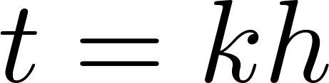
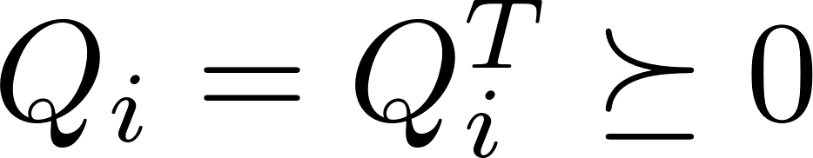
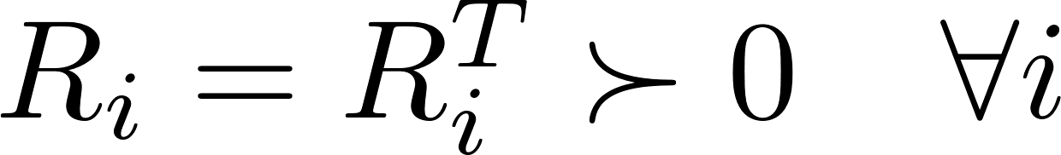
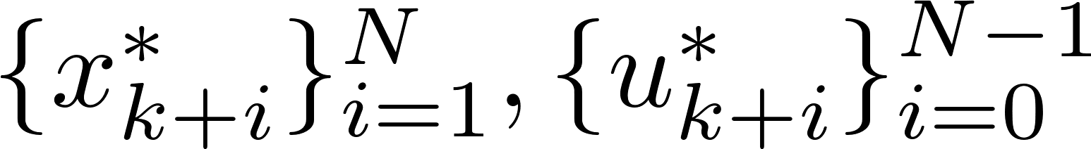
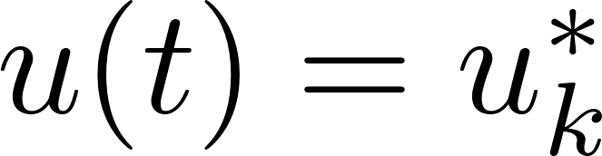
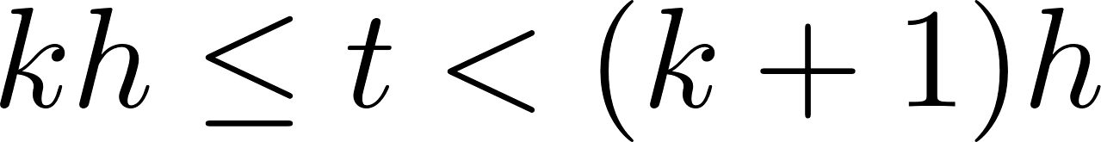
MPC of Rigid Body
Recap: Linear Model Predictive Control
Continuous linear system and discretized linear system
Discretization with time step h
Fix a time horizon in discrete time or in continuous time.
At sampling time , solve the optimization problem
with and ,
subject to
denote solution by
we take over the current time interval

Slide 3
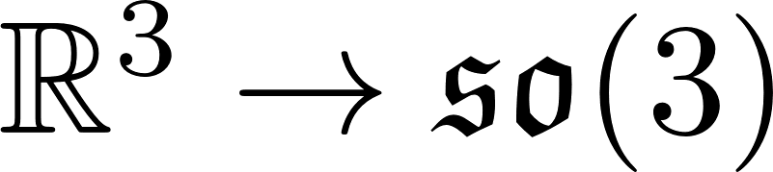
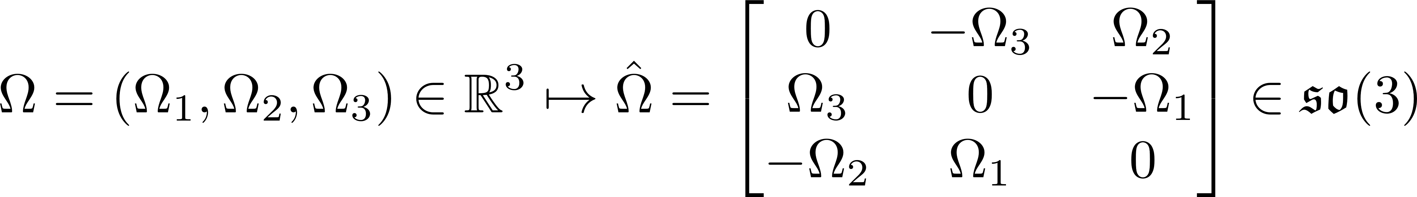

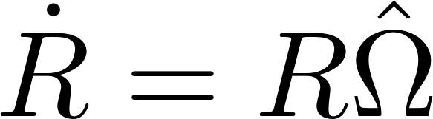
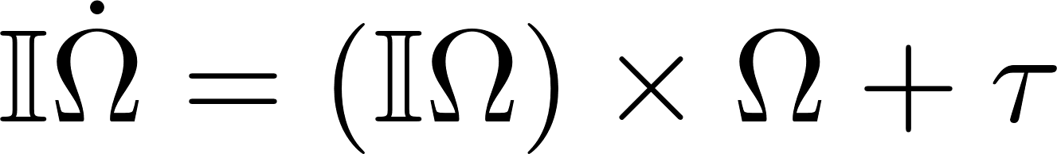
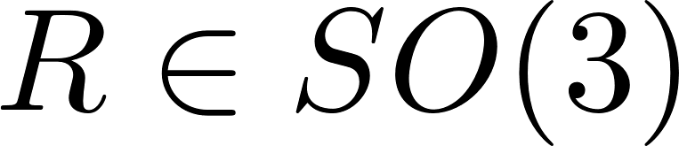
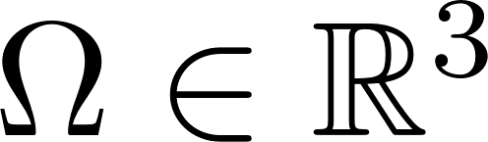
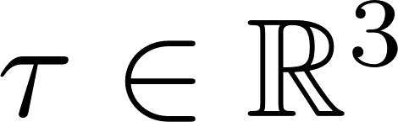
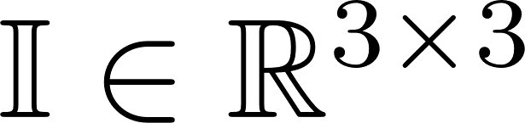
MPC of Rigid Body
Rigid Body Dynamics
Hat map : :
Vee map : :
The inverse map of the hat map
Rigid body dynamics
where rotation, body angular velocity, torque vector viewed in the body-fixed frame, moment-of-inertia matrix symmetric and positive definite.

Slide 4
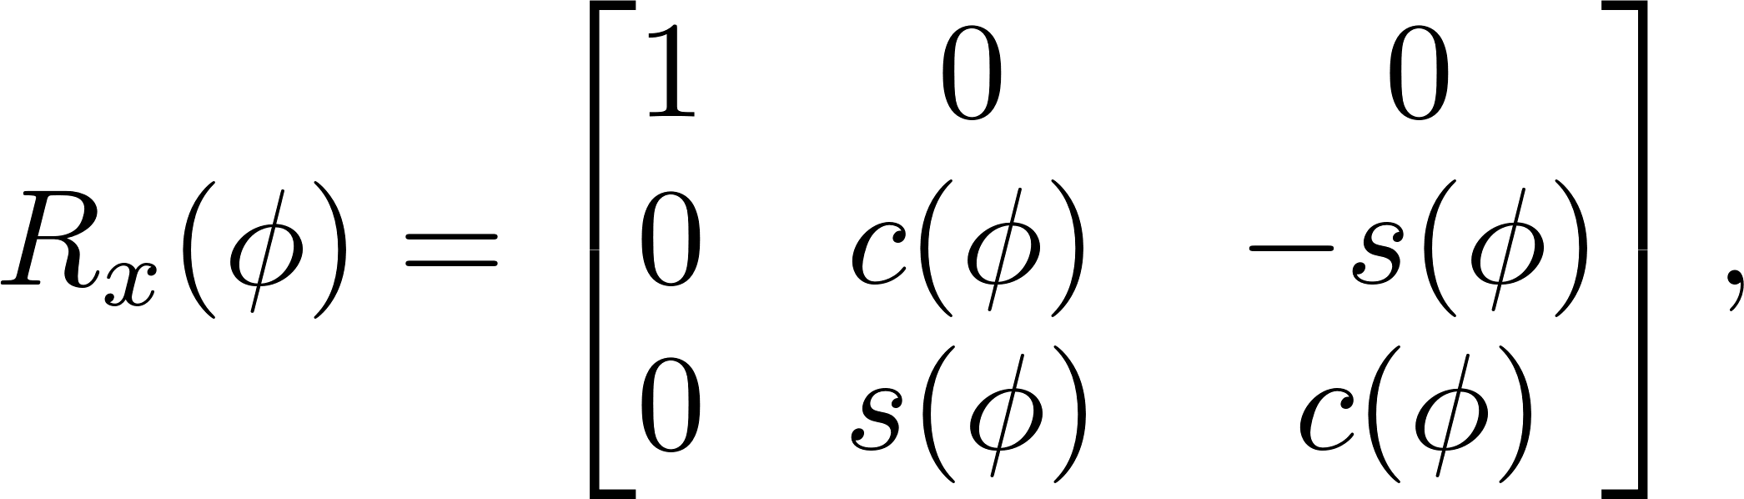
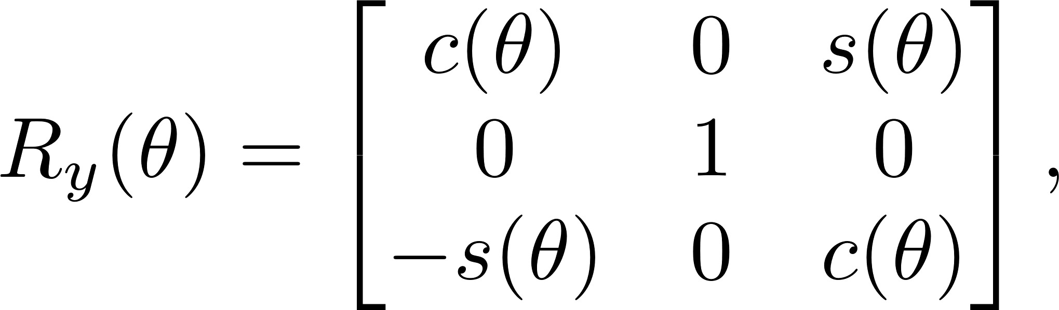
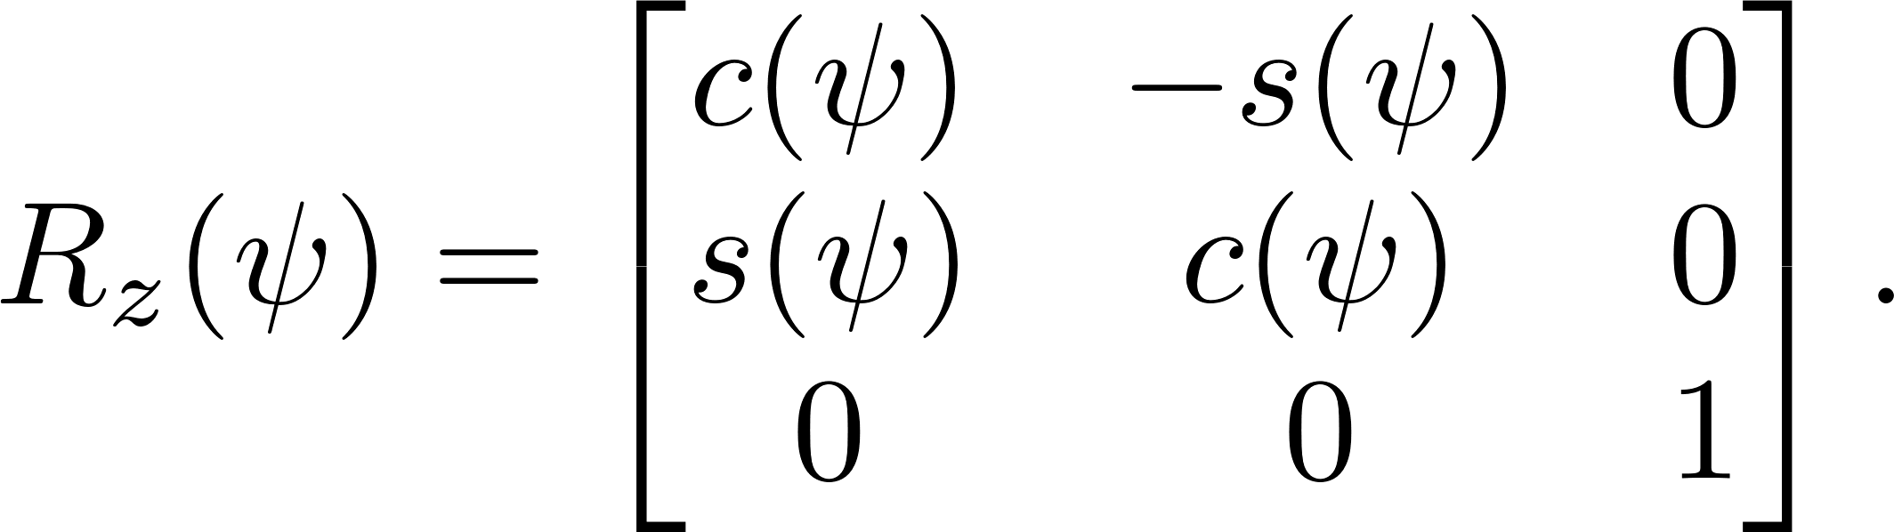
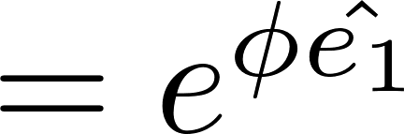
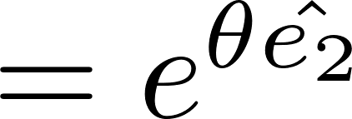
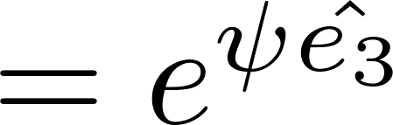

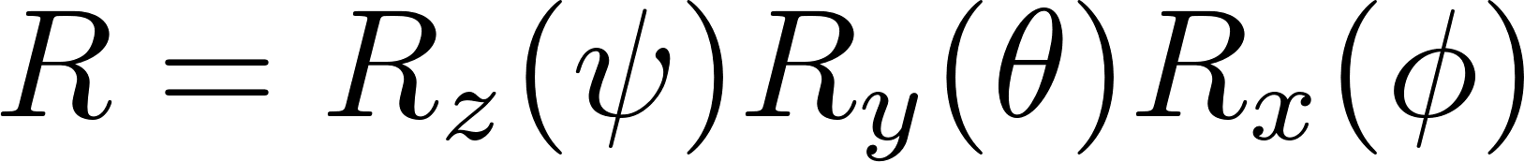
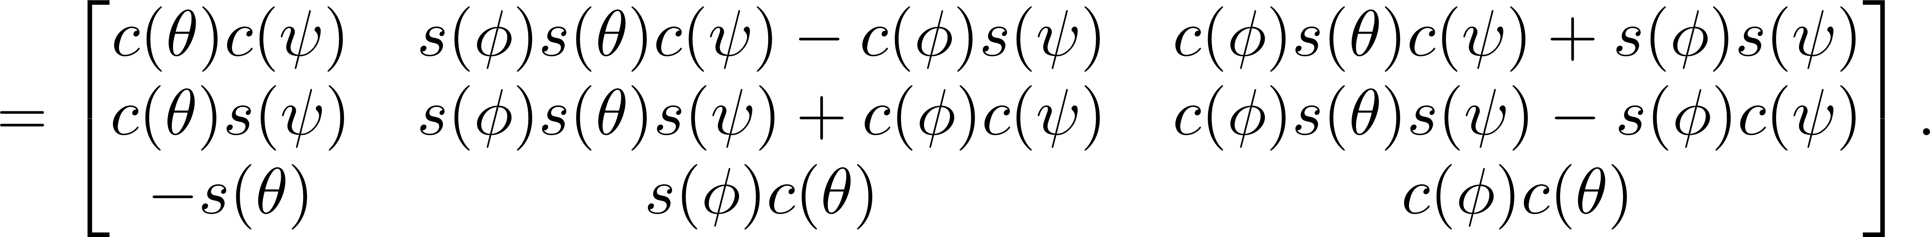

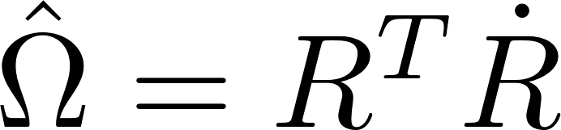
MPC of Rigid Body
Rigid Body Dynamics
The rotation matrix can be represented as
Differentiate in
Multiply both sides by and use :

Slide 5
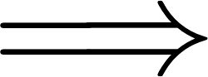

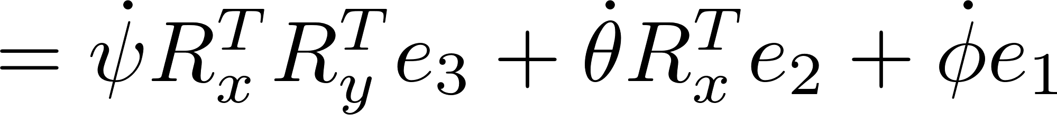
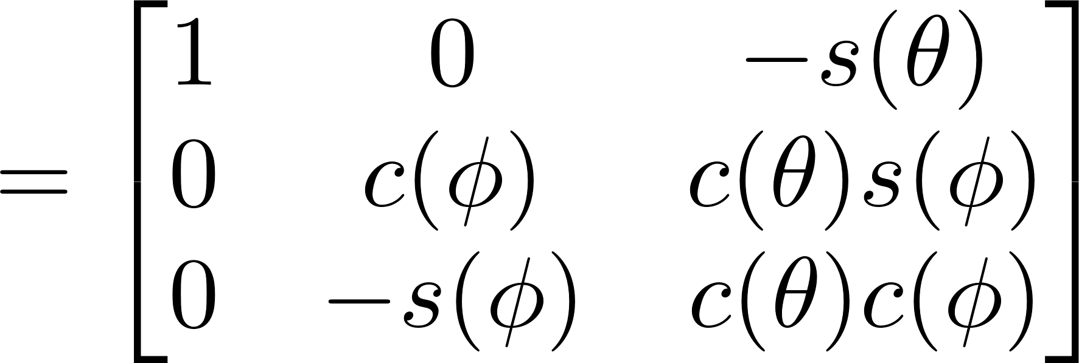
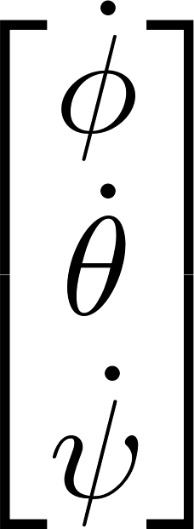
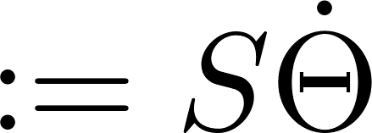
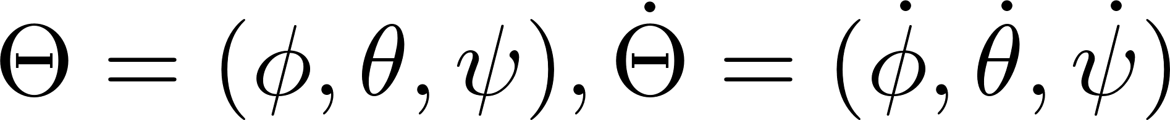
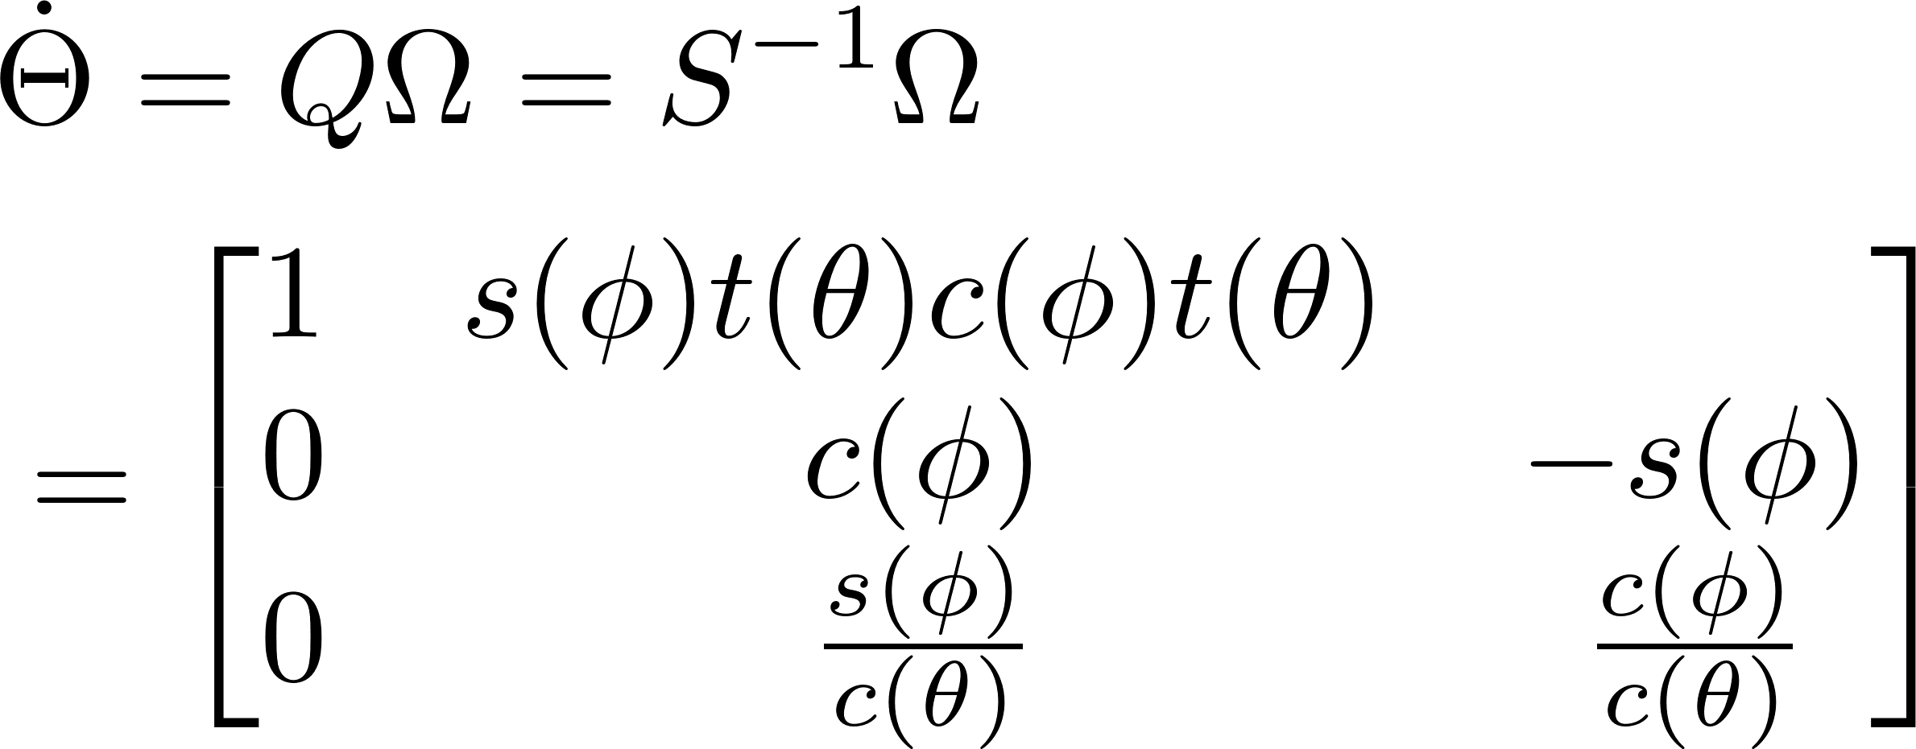
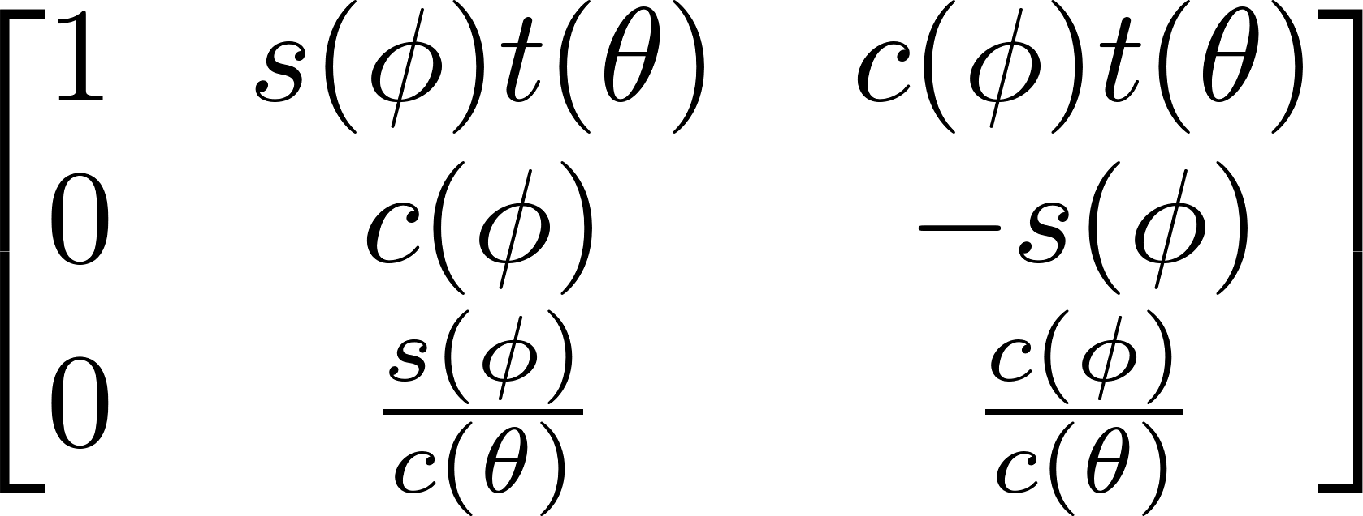
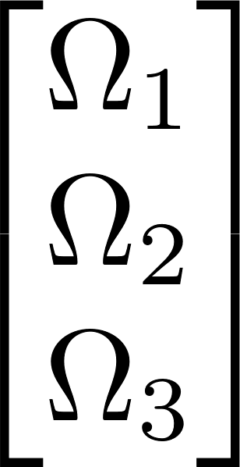
MPC of Rigid Body
Rigid Body Dynamics
where

Slide 6

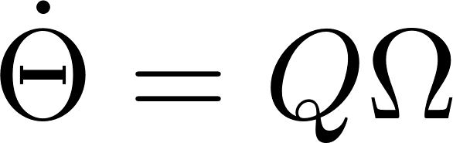
MPC of Rigid Body
Rigid Body Dynamics
Change of coordinates:
Use this rigid body dynamics for MPC

Slide 7

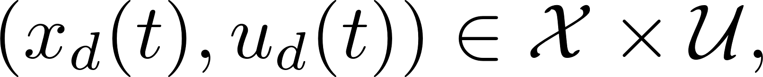
MPC of Rigid Body
Recap: Linearization Along Trajectory
Given a system
and a reference trajectory
Linearization of along reference trajectory:
where

Slide 8
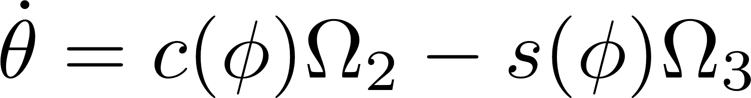

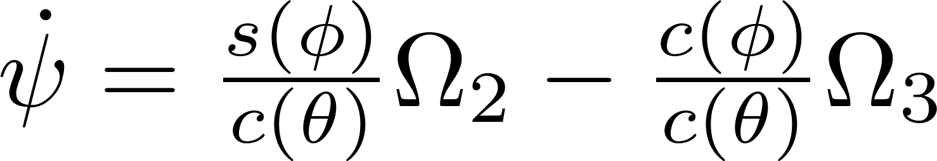

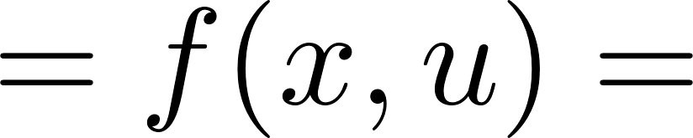
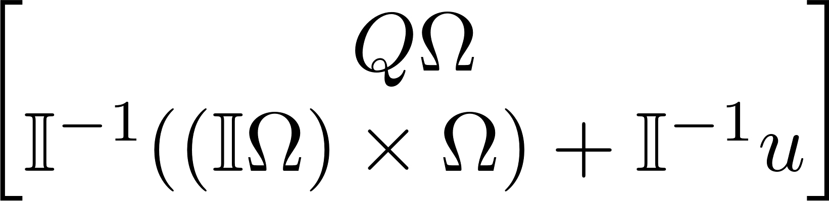
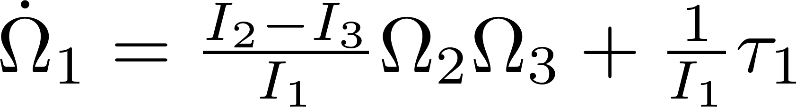
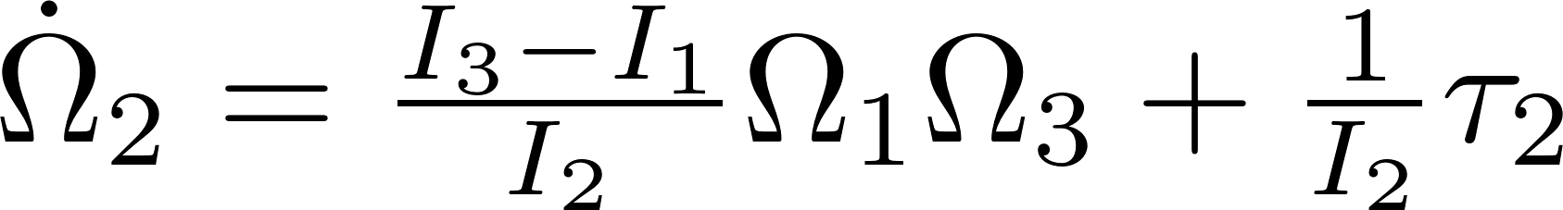
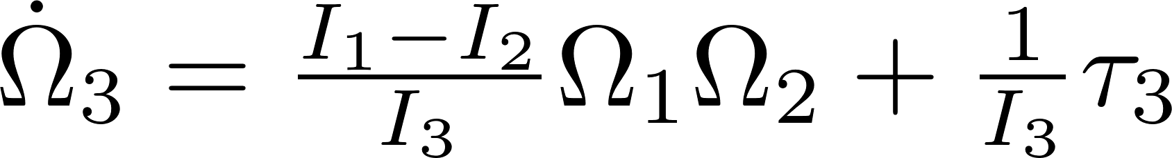
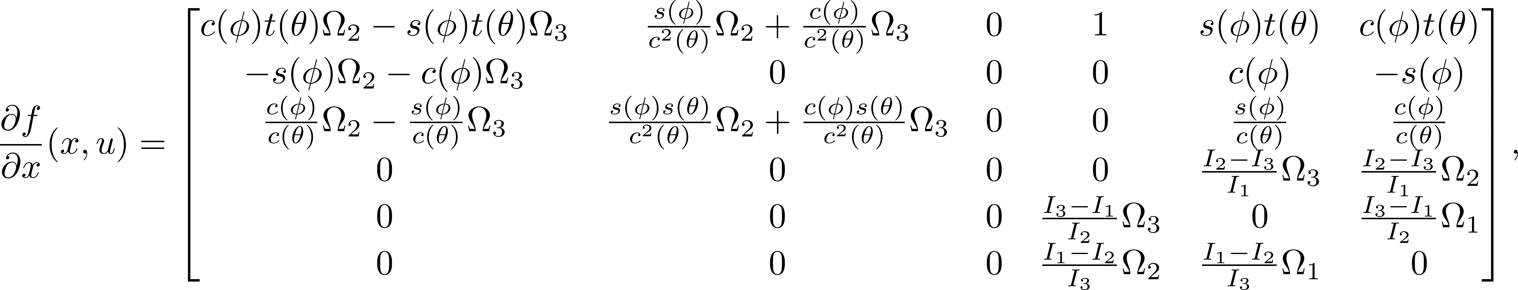
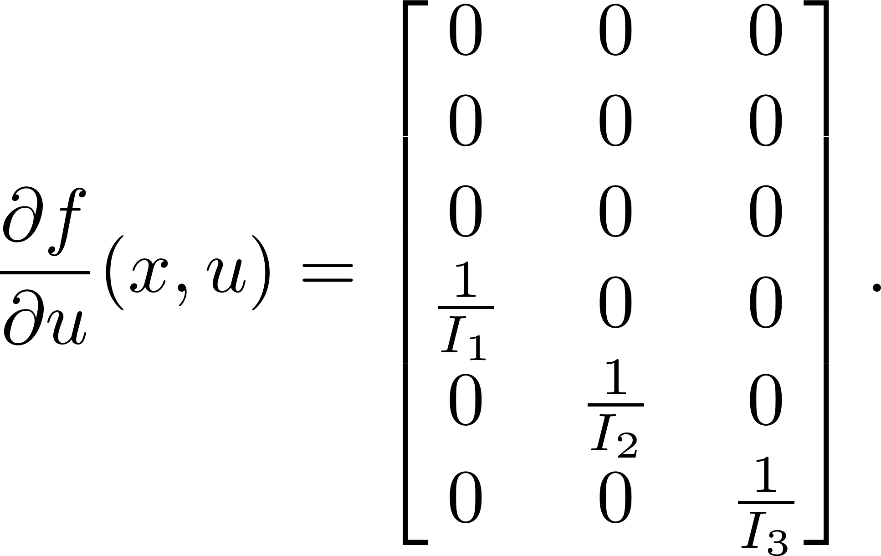
MPC of Rigid Body
Linearized Rigid Body System

Slide 9
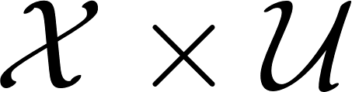
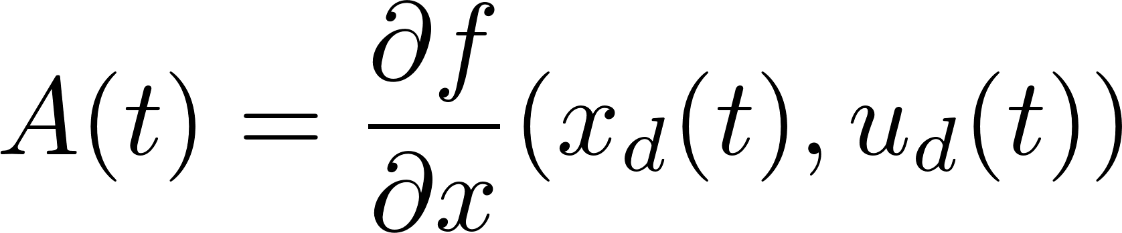
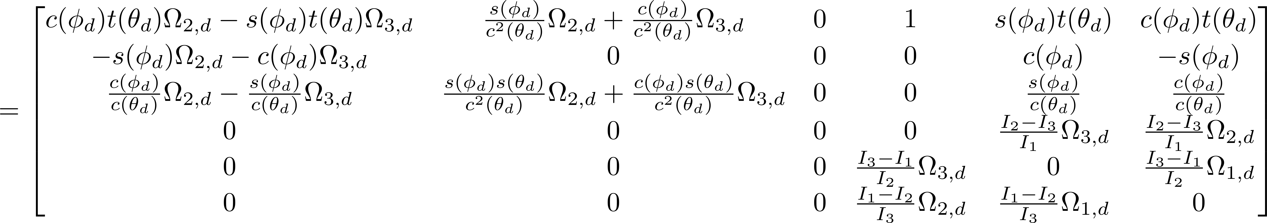
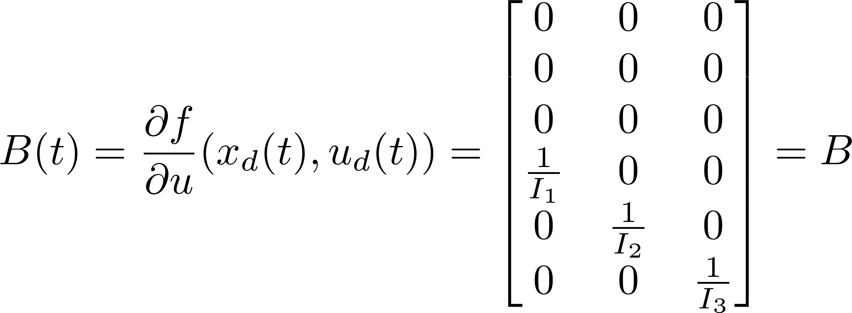
MPC of Rigid Body
Linearized Rigid Body System
Given a reference trajectory
Linearized rigid body system

Slide 10
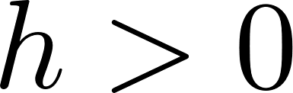
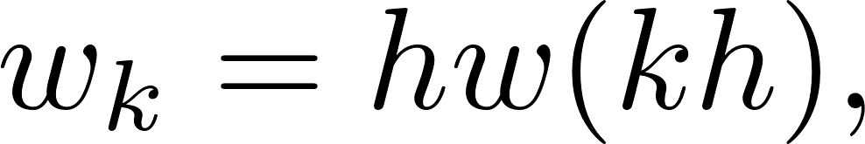
MPC of Rigid Body
Discrete Linear Rigid Body System
Discretize the continuous system by Euler’s method with time step :
where

Slide 11
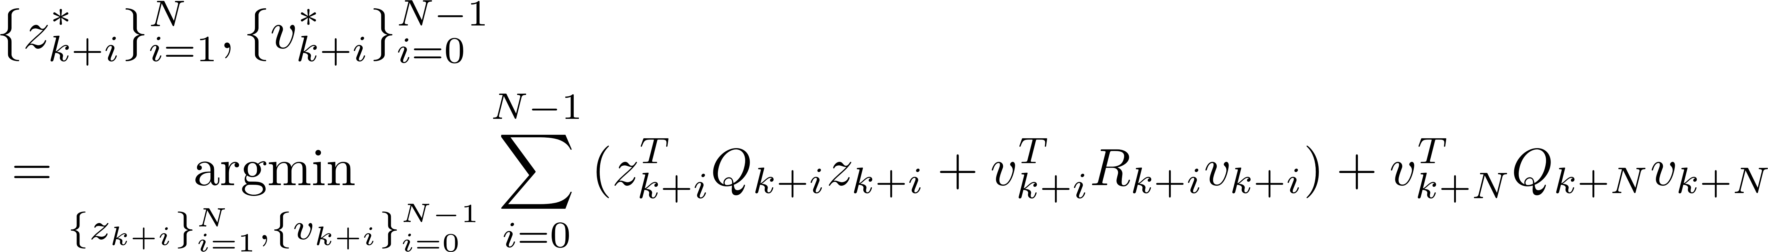

MPC of Rigid Body
MPC of Discrete Linear Rigid Body System
Fix a time horizon in discrete time or in continuous time.
At sampling time , solve the optimization problem
with and ,
subject to
we take over the current time interval

Slide 12


MPC of Rigid Body
MPC of Discrete Linear Rigid Body System

Slide 13
MPC of Rigid Body
Implementation
Experimental Setup
sampling time: h = 0.1 sec,
MPC time horizon: N = 4,
Simulation time: 10 sec,
moment-of-inertia matrix: .
MATLAB files for simulation
simul.m
sys.m
mpc.m
reference.m
dynamics_const.m

Slide 14












MPC of Rigid Body
Implementation
reference.m : Generate a reference trajectory that satisfies the rigid body dynamics
$$(φ_{d} θ_{d}, ψ_{d})$$
$$({\dot{φ}}_{d},{\dot{θ}}_{d},{\dot{ψ}}_{d})$$
$$S=\left[\begin{matrix}1 & 0 & −s(θ_{d}) \\ 0 & c(φ_{d}) & c\left(θ_{d}\right)s(φ_{d}) \\ 0 & −s(φ_{d}) & c\left(θ_{d}\right)s(φ_{d})\end{matrix}\right]$$
$$({\ddot{φ}}_{d},{\ddot{θ}}_{d},{\ddot{ψ}}_{d})$$
$$Ω_{d}=S{\dot{Θ}}_{d}$$
$${\dot{Ω}}_{d}=\dot{S}{\dot{Θ}}_{d}+S{\ddot{Θ}}_{d}$$
$$\dot{S}=\left[\begin{matrix}0 & 0 & c\left(θ_{d}\right){\dot{θ}}_{d} \\ 0 & −s\left(φ_{d}\right){\dot{φ}}_{d} & −s\left(θ_{d}\right)s\left(φ_{d}\right){\dot{θ}}_{d}+c\left(θ_{d}\right)c\left(φ_{d}\right){\dot{φ}}_{d} \\ 0 & −c\left(φ_{d}\right){\dot{φ}}_{d} & −s\left(θ_{d}\right)c\left(φ_{d}\right){\dot{θ}}_{d}−c\left(θ_{d}\right)s\left(φ_{d}\right){\dot{φ}}_{d}\end{matrix}\right]$$
$$(x_{d}\left(t\right),{\dot{x}}_{d}\left(t\right))$$
$u_{d}\left(t\right)=τ_{d}\left(t\right)=𝕀{\dot{Ω}}_{d}−(𝕀Ω_{d})×Ω_{d}$
reference.m
time $t$
$$(x_{d}\left(t\right),{\dot{x}}_{d}\left(t\right),u_{d}(t))$$

Slide 15


MPC of Rigid Body
Implementation
dynamic_const.m : Generate MPC constraints related to rigid body dynamics
$$⋮$$
Expression for optimization variables
$$⋮$$

Slide 16







MPC of Rigid Body
Implementation
dynamic_const.m
Expression in affine form
Equality constraint:

Slide 17








MPC of Rigid Body
Implementation
dynamic_const.m ($1$)
At $t=kh, (x_{d}\left(\left(k+i\right)h\right), {\dot{x}}_{d}\left(\left(k+i\right)h\right), u_{d}\left(\left(k+i\right)h\right))$
$$Θ_{d}(\left(k+i\right)h)$$
$$Ω_{d}(\left(k+i\right)h)$$
$$A\left(t\right)=\frac{∂f}{∂x}\left(x_{d}(t),u_{d}(t)\right)$$
A_temp $=$ $$A(\left(k+i\right)h)$$
$$A_{k}=I+hA(kh)$$
$$A_{k+i}=I+hA(\left(k+i\right)h)$$

Slide 18







MPC of Rigid Body
Implementation
dynamic_const.m ($2$)
B_temp $=\frac{∂f}{∂u}\left(x_{d}\left(t\right),u_{d}(t)\right)=B$
$$B_{k}=hB\left(kh\right)=hB$$
$$B_{k+i}=hB$$
$$w_{k}=hw\left(kh\right)=h(f\left(x_{d}\left(kh\right),u_{d}\left(kh\right)\right)−{\dot{x}}_{d}\left(kh\right))$$
time $t$
current error $z_{k}$
sampling time $h$
time horizon $N$
dynamic_ const.m
$$A_{eq}, b_{eq}$$

Slide 19





MPC of Rigid Body
Implementation
mpc.m
* Kronecker product :
Given and ,
MATLAB function: kron(M,N)
* fmincon :

Slide 20








MPC of Rigid Body
Implementation
mpc.m
$$Q=Q_{k+i} , i=0,⋯,N−1$$
$I_{(N−1)×(N−1)}⊗Q={\left[\begin{matrix}Q & ⋯ & 0 \\ ⋮ & ⋱ & ⋮ \\ 0 & ⋯ & Q\end{matrix}\right]}_{6\left(N−1\right)×6(N−1)}$
$$R=R_{k+i} , i=0,⋯,N−1$$
$$S=Q_{k+N}$$
initial estimated solution for fmincon
Cost function
Equality constraint ($A_{eq}X=b_{eq}$)
Take only
time $t$
current error $z_{k}$
sampling time $h$
time horizon $N$
mpc.m

Slide 21






MPC of Rigid Body
Implementation
sys.m : function for rigid body simulation of ode45
$v_{k}^{∗}$ from MPC
$$Θ(t)$$
$$Ω(t)$$
$$u_{d}(kh)$$
$$τ\left(t\right)=u(t)=v_{k}^{∗}+u_{d}(kh)$$
Rigid Body Dynamics
we take over the current time interval

Slide 22






MPC of Rigid Body
Implementation
simul.m
initial state
for each $kh≤t<\left(k+1\right)h$
generate reference trajectory at $t=kh$
$$z_{k}=δx_{k}=x\left(kh\right)−x_{d}(kh)$$
generate $v_{k}^{∗}$
simulate with ode45 in $kh≤t≤\left(k+1\right)h$
store the simulation result
store the reference state (for plotting graphs)

Slide 23
MPC of Rigid Body
Simulation Result

Slide 24
Thank you!

Slide 25

MPC of Rigid Body
Appendix1

Slide 26


MPC of Rigid Body
Appendix2
initialize.m : generate initial state for fmincon (satisfies the constraint)
$$⋮$$

